Slide 1

Argus: Scalable and Deterministic Network Fault Localization for AI Training Clusters
Yuxiang Wang†, Jiao Zhang†∗, Xianyu Huang† , Yubo Ruan † ,Yuxuan Hu †, Yingjie Duan‡, Shoushou Ren‡, Xianjun He‡, Junlong Chen †, Yuan Li †, Tao Huang †
†State Key Laboratory of Networking and Switching Technology, BUPT, China
‡HUAWEI, China
1

Slide 2
Outline
01
Background and Motivation
02
Design and Implementation
03
Evaluation
Conclusion
04
2

Slide 3
The Era of Massive AI Training Clusters
01
02
03
Unprecedented Scale
RDMA as Backbone
Failure Impact
Training of LLMs demands enormous computational power,with clusters utilizing massive parallel processing.
High-bandwidth,low-latency RDMA networks facilitate critical collective communication between nodes.
The "barrel effect" means a single faulty link can degrade the entire cluster's performance.
10,000+ GPUs
All-Reduce
All-to-All
0.01% drops

Slide 4
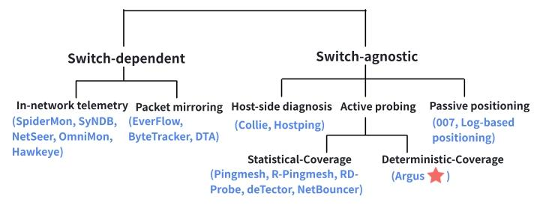
Limitations of Current Fault Localization Approaches
Current methods face significant challenges in AI training clusters,leaving critical gaps in reliability.
Switch-dependent
Passive Methods
Active Probing
Require specialized hardware(e.g.,P4 switches),which is not always feasible in all clusters.
Are reactive by nature and cannot proactively detect or predict issues before they occur.
e.g.,Pingmesh—Sends probes to measure network health,but has fundamental limitations.
Infrastructure is costly and deployment across heterogeneous environments is challenging.
Reliant on real-time data streams;lack of visibility into the health of idle or low-utilization paths.

Slide 5
Motivations: Key Goals for Ideal Fault Localization
01
02
03
Achieving Deterministic Coverage
Zero-Overhead Path Derivation
Ensuring Fault Distinguishability
Current probabilistic probing (e.g., Pingmesh) leads to uneven coverage and blind spots. An ideal system must guarantee 100% deterministic link coverage to avoid missing faults.
Path discovery methods like `traceroute` consume switch CPU and bandwidth. An ideal system should derive probe paths offline with zero network overhead.
Concurrent failures often produce identical signatures with current methods. An ideal system must ensure unique fault signatures to accurately distinguish and localize multiple simultaneous failures.
5

Slide 6
Outline
01
Background and Motivation
02
Design and Implementation
03
Evaluation
Conclusion
04

Slide 7
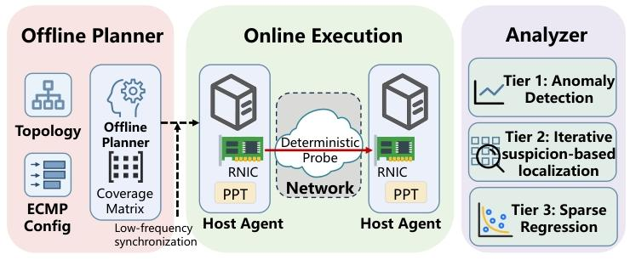
System Overview of Argus
Offline Planner
Host Agents
Analyzer
Computes exact paths for candidate probes.
Selects a minimal set of probes for full coverage and distinguishability.
Outputs a “pinglist” to host agents.
Execute RDMA UD probes according to the pinglist.
Record outcomes and send lightweight reports.
Collects reports and performs fault localization using a tiered approach.
7

Slide 8
Hash-aware Probe Planning
01
02
03
Deterministic Coverage Matrix
Probe Selection
Edge Signatures
The planner replays the ECMP hash computation offline to build a matrix mapping probes to the links they traverse.
Using ILP or a greedy algorithm, the planner selects a minimal set of probes to ensure 100% link coverage.
Probes are chosen to maximize the Hamming distance between link signatures,ensuring any two links can be distinguished.
8

Slide 9
Tiered Diagnosis
Challenges
Hard Failures
Gray Failures
Complete link outages that result in total service disruption.
Subtle performance degradations,such as increased latency or low packet loss rates.
Design
1
Tier 1
2
Tier 2
3
Tier 3
Anomaly Detection
Localization
Regression
Flags probes with significant deviations from baselines to identify potential issues early.
Uses a suspicion-based algorithm to iteratively localize the exact source of hard failures.
Applies non-negative LASSO to correlate RTT deviations with per-link latency to quantify gray failures.
9

Slide 10
Outline
01
Background and Motivation
02
Design and Implementation
03
Evaluation
Conclusion
04

Slide 11
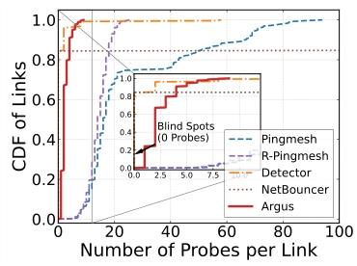
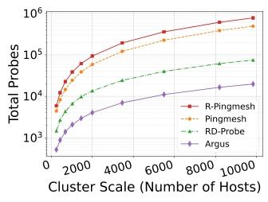
Probe Efficiency and Scalability
Uniform Coverage
Argus achieves balanced coverage (1-3 probes/link),completely eliminating blind spots across all network links.
Probe Reduction
fewer probes than R-Pingmesh for a 9,826-host cluster, while still achieving 100% coverage.
39x
Distribution of probes per link
Total Probes for 100% coverage
Argus achieves 100% coverage with unprecedented efficiency and scalability

Slide 12
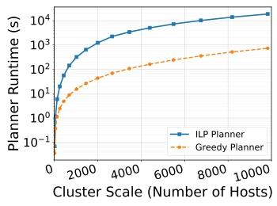
Planner Runtime
12mins
Plan the network for 9,826 hosts.
Greedy planners can efficiently handle large-scale clusters and are well-suited for dynamic environments where network topologies change frequently.
The greedy planner efficiently handles large clusters,taking only 12 minutes to plan for a 9,826-host network,making it suitable for dynamic environments.
12

Slide 13
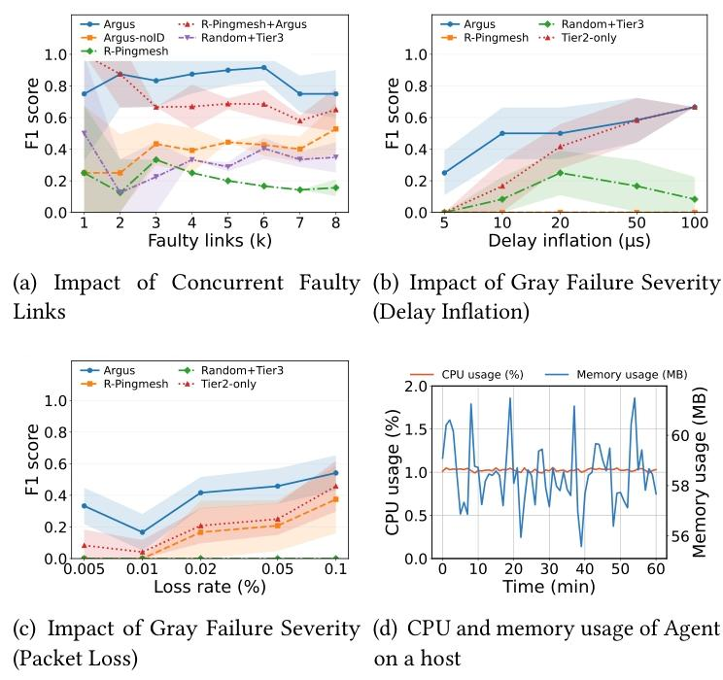
Evaluation:Localization Accuracy
Multi-link Failures
0.75-0.92
Maintains high F1 scores for 1-8 concurrent failures,far outperforming baselines.
Gray Failures(Delay)
0.67at 100µs delay
Successfully detects subtle latency increases,while baselines fail entirely.
Gray Failures(Loss)
Detects low packet loss rates,where baselines only detect higher rates.
0.005%-0.1%
13

Slide 14
Runtime Overhead
The Argus agent is extremely lightweight,consuming minimal system resources.
CPU
Memory
1.0%
58MB
Average CPU utilization across all hosts
Average memory footprint per agent
This minimal overhead is achieved by offloading all complex computation to the offline planner and centralized analyzer.
This ensures that the agent remains a lightweight process on each host,without impacting the performance of production training workloads.

Slide 15
Outline
01
Background and Motivation
02
Design and Implementation
03
Evaluation
Conclusion
04

Slide 16
Conclusion
01
02
03
Unprecedented Efficiency
High Accuracy
Minimal Overhead
Achieves 100% link coverage with drastically fewer probes—39x less than R-Pingmesh.
Far more efficient than state-of-the-art while covering every network link.
Effectively distinguishes and localizes both hard failures and gray failures.
Uses edge signatures and tiered diagnosis to pinpoint fault locations with precision.
Operates with negligible impact on host resources.
Lightweight design makes it suitable for large-scale production environments without disrupting workloads.
16

Slide 17
Thank You!
Contact Email
Wang_yx@bupt.edu.cn

